Slide 1


Presentation Title: Wi-Fi
Course Title: Wireless and Mobile Communication
Course Code: ICT - 4201
Presented By Shusmita Ghosh Shoili ID: IT21006 Session: 2020-21 Dept. of ICT, MBSTU | Presented To, Dr. Nazrul Islam Associate Professor, Dept. of ICT, MBSTU

Slide 2


What is Wi-Fi?
Wi-Fi (Wireless Fidelity) is a wireless networking technology that uses radio waves to provide high-speed internet and network connections.
It allows devices like laptops, smartphones, and smart TVs to connect to the internet without physical cables.
Wi-Fi is based on IEEE 802.11 standards for Wireless Local Area Networks (WLAN).

Slide 3
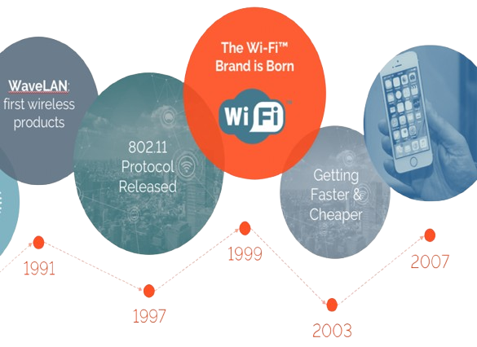
History of Wi-Fi
1991: Wi-Fi technology originated from a project called 'WaveLAN' by NCR and AT&T.
1997: IEEE introduced the first 802.11 standard with 2 Mbps speed.
1999: Wi-Fi Alliance was formed to promote interoperability.
2000s–Present: New versions like 802.11a/b/g/n/ac/ax improved range, speed, and reliability.

Slide 4
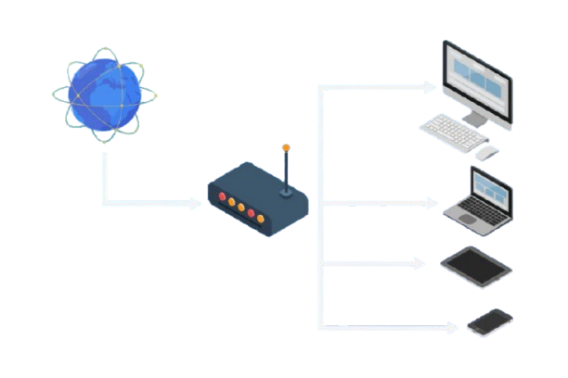
How Does Wi-Fi Work?
Wi-Fi uses radio frequency (RF) signals to transmit data between a router and wireless-enabled devices.
Basic Steps:
Data is converted to radio signals by the router.
These signals travel through airwaves to the receiver (device).
The device converts signals back into usable data.
This system operates typically in 2.4 GHz and 5 GHz frequency bands.

Slide 5
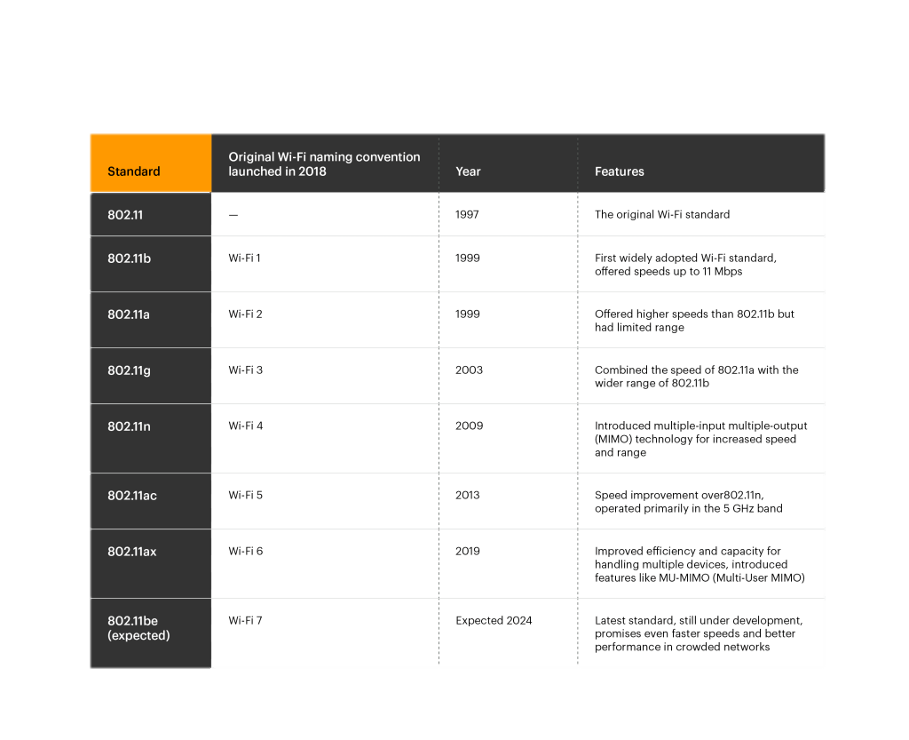
Wi-Fi Standards
Overview
802.11a: 5 GHz band, up to 54 Mbps.
802.11b: 2.4 GHz band, up to 11 Mbps.
802.11g: 2.4 GHz band, up to 54 Mbps.
802.11n: Dual-band (2.4 & 5 GHz), up to 600 Mbps.
802.11ac: 5 GHz band, up to several Gbps.

Slide 6
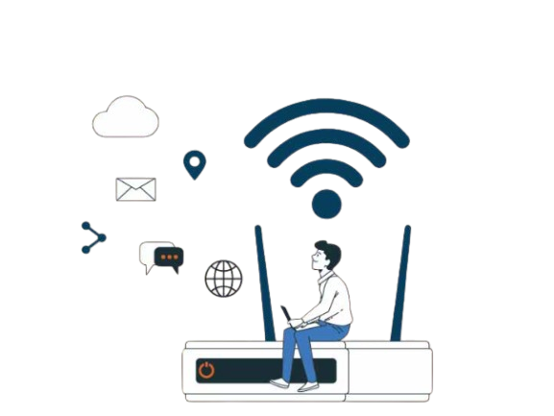
Modes of Operation
Infrastructure Mode: Devices connect through a central access point (AP).
Ad-Hoc Mode: Devices communicate directly without an AP.
Wi-Fi Direct: Peer-to-peer connections between devices.
Hotspot Mode: Device acts as an access point for others.

Slide 7
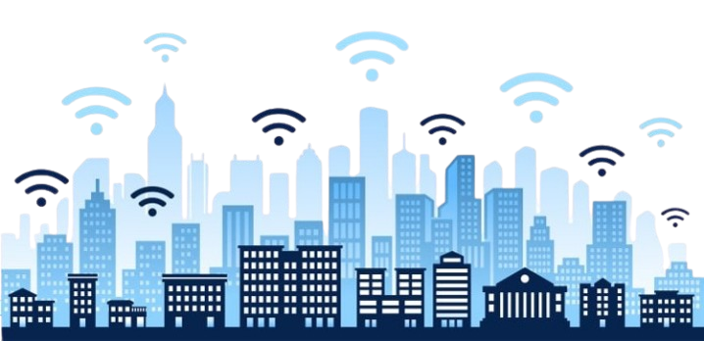
Applications of Wi-Fi
Home Networks: Internet access for multiple devices.
Educational Institutions: Smart classrooms and campus networks.
Business and Enterprises: Office connectivity, cloud access, and VoIP.
Public Hotspots: Airports, cafes, and public transport.
IoT Devices: Smart home systems, sensors, and automation.

Slide 8
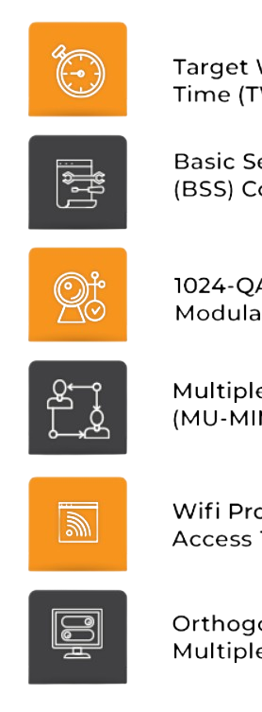
Advantages of Wi-Fi
Advantages:
Easy to install and expand.
Supports mobility and portability.
Cost-effective (no cables required).
Can connect multiple devices simultaneously.
Compatible with most modern devices.

Slide 9
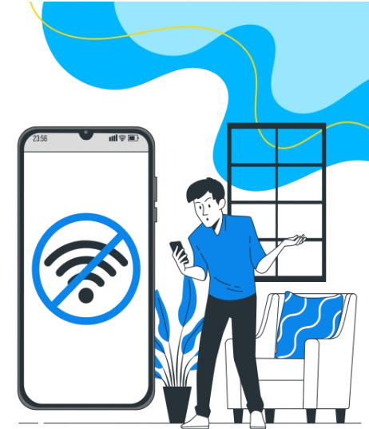
Limitations of Wi-Fi
Limitations:
Signal interference from walls or other devices.
Security vulnerabilities (e.g., hacking risks).
Limited range compared to wired connections.
Performance drops with distance or congestion.

Slide 10
Wi-Fi vs Other Technologies
Range: Wi-Fi works up to 100 meters, longer than Bluetooth but shorter than cellular networks.
Speed: High-speed internet, faster than Bluetooth, similar or slightly lower than 5G in ideal conditions.
Power: Moderate power consumption, more than Bluetooth, less than cellular.
Connection: Devices connect via an access point or directly (Wi-Fi Direct).
Security: Secured with WPA2/WPA3 protocols — safer than open Bluetooth connections.
Use: Best for local area networks, home and office internet, streaming, and smart devices.

Slide 11

Conclusion
Wi-Fi is the backbone of modern wireless communication. Its evolution from 802.11a to Wi-Fi 6 has revolutionized connectivity speed and reliability. Despite some limitations, Wi-Fi remains essential for personal, academic, and business communication. Future developments (like Wi-Fi 7) aim for faster, more secure, and more efficient wireless networks.

Slide 12
Thank You

